Slide 1
Sculptural Illustration
Curator - Robert Young

Slide 2
Sculptural Illustration
Illustration exists almost entirely on the printed page when consumed by its intended audience, whether it’s a book cover, a spot illustration accompanying an editorial piece, an advertisement in a magazine etc. Often, these images are only viewed for a matter of seconds and little consideration is given by the viewer as to how the image was made and what it consists of from the standpoint of technique. Many people, when asked how an illustration Is made, would easily and confidently answer that it is drawn, and this would be correct a vast majority of the time, but not all illustration is drawn. Just as is the case with any other form of visual art, the possibilities are endless when it comes to how to make a picture, and just as is the case between different disciplines of fine art (ie. Between painting and sculpture) the line of fine art and illustration blurs when we examine some gallery based artists and find that they are, in fact, creating illustrative sculpture. This exhibition is a display of illustration that is based in the three dimensional realm of sculpture.

Slide 3
Cut Paper
Perhaps the simplest entry point into sculptural illustration is cut paper. Often this is done by layering pieces of paper giving only a slightly more dimensional look than that of a purely drawn illustration, however, it can also be used as a planar sculptural form to create three dimensional objects. This is also possibly the first form of sculptural illustration as paper was invented in China around AD 105 by Cai Lun and was very soon after used as a substrate to cut into and form images. The act of cutting a shape out of paper is also directly analogous to the act of using a marking tool to leave a mark on paper.

Slide 4
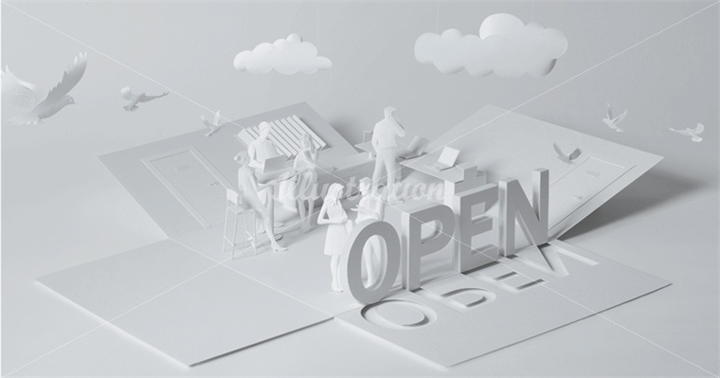
Untitled
Gail Armstrong
Cut Paper

Slide 5
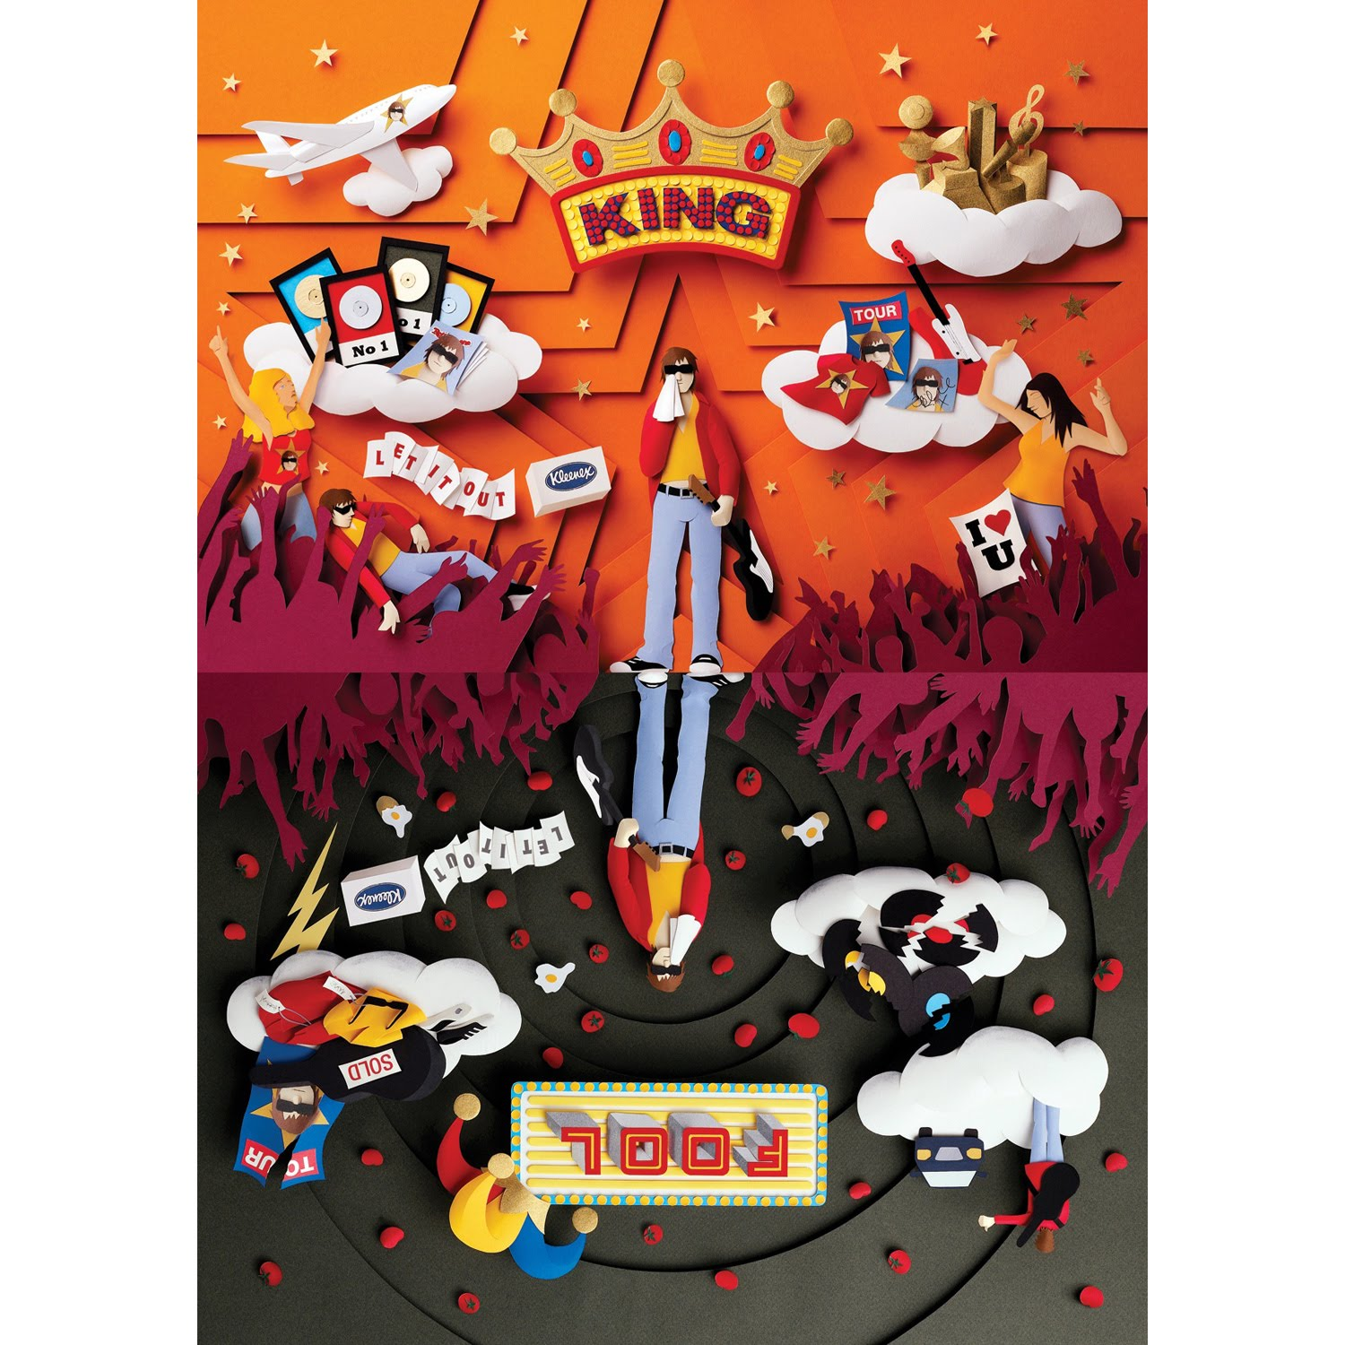
Untitled
Gail Armstrong
Cut Paper

Slide 6
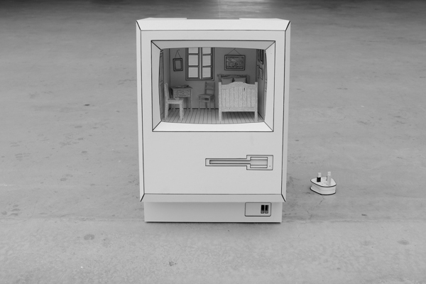
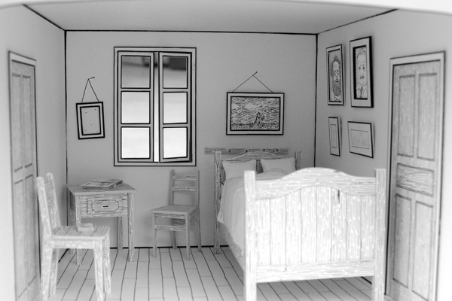
Object #3
Kevin LCK
Ink and Cut Paper
Kevin LCK refers to these objects as illustrative and they are presented as causing an introspective experience for the viewer that asks questions rather than answers them. His sculptures recontextualize what we expect from a certain space or object to give light to an idea. In this instance, they are about the modern phenomenon of spending so much time inside your electronic device that it is as if you live there.

Slide 7
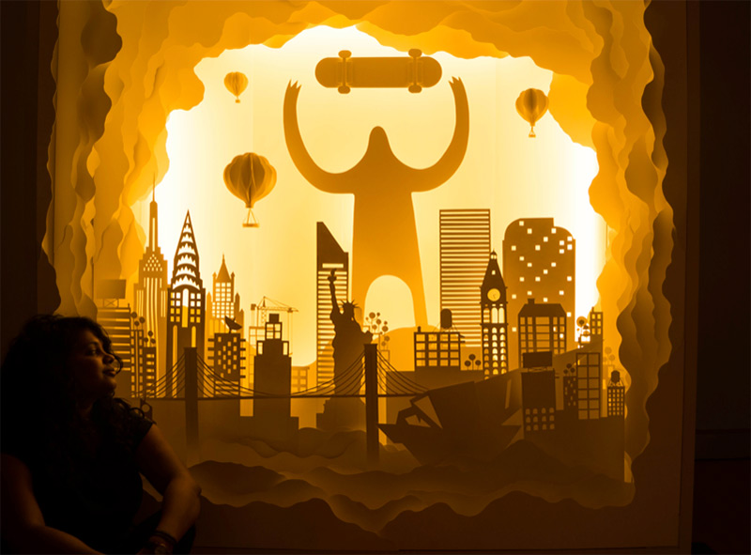
Untitled
Hari and Deepti
Cut Paper and Light
6’x6’x2’
Hari and Deepti are an artist couple who use layered cut paper and methodically placed LED light strips to create other-worldly scenes. Their approach to making these sculptures is similar to the way an artist would create an illustrated tunnel book.

Slide 8
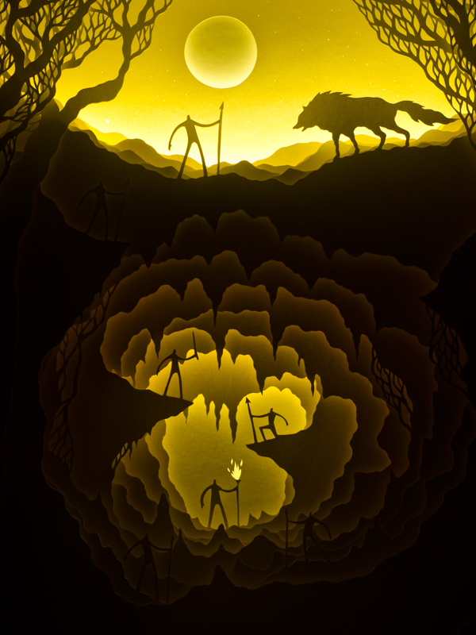
Moonlight Drowns Out All but the Brightest Stars
Hari and Deepti
Cut Paper and Light
12”x16”

Slide 9
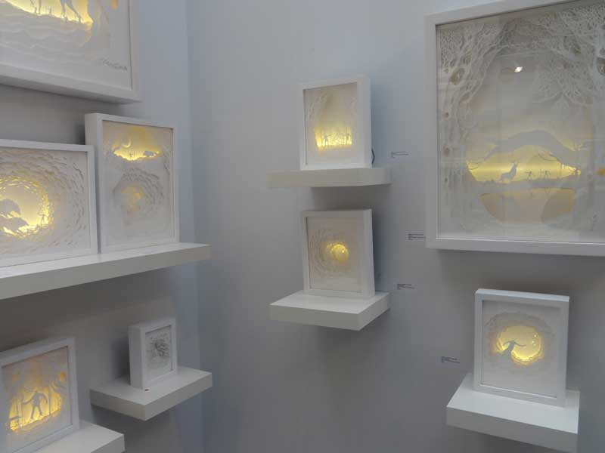

Slide 10
Sculptural Diorama
One of the advantages of sculpture over two dimensional drawing or painting, is the ability to walk around the sculpture and experience it from all sides including from above and underneath. Walking around the ancient greek statue of Laocoon and his Sons is a wholly different experience than viewing El Greco’s painting of Laocoon and his sons. The applications of diorama vary greatly and it is interesting, then, to see what influences artists use to create narrative, illustrative diorama.

Slide 11
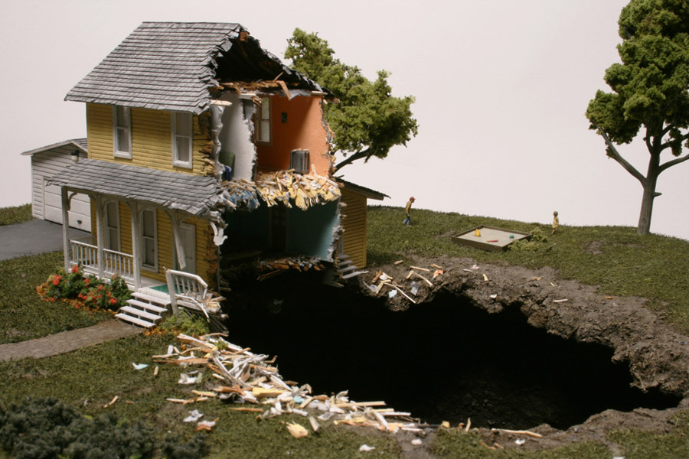
Armistice 2011
Thomas Doyle
Mixed Media
25” x 21” x 18”
Thomas Doyle uses the same techniques and materials as model railroad builders to depict eerie, unsettling scenes of suburban mundane inflicted with the surreal and horrific. In Armistice, children play around a sandbox in a suburban yard while some unseen and unnoticed force has taken a deep swath out of the house and yard mere feet from the children. An idyllic middle class dream is juxtaposed with some unknown destructive force. The narrative is vague and open ended yet compelling

Slide 12
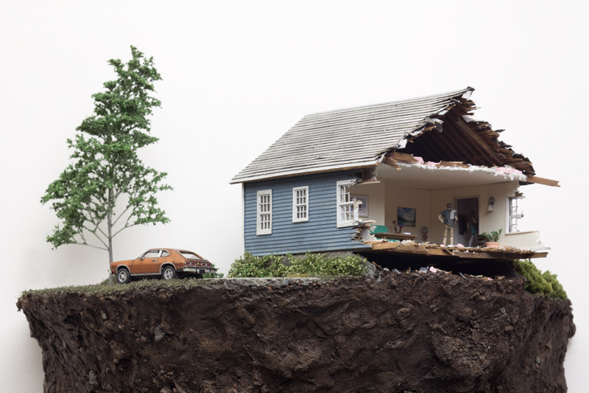
Proxy 2013
Thomas Doyle
Mixed Media
27”x11.75”x8”
Doyle’s scenes often contain two figures. These figures display a sort of domestic tension that is pervasive in Doyle’s work. In a typically fine art fashion, he is interested in showcasing a frozen moment in time that is right before, or right after some sort of event, but he is not interested in fully fleshing out a story and spelling it out for viewers, opting to allow the viewer to come to their own conclusion about what sort of narrative they are witnessing.

Slide 13
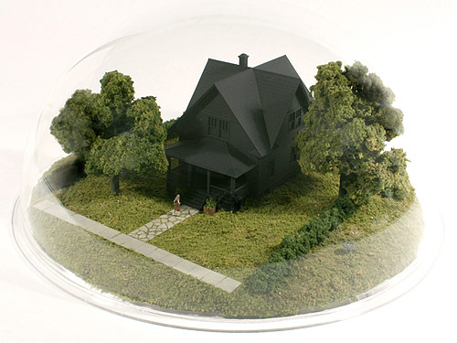

Slide 14
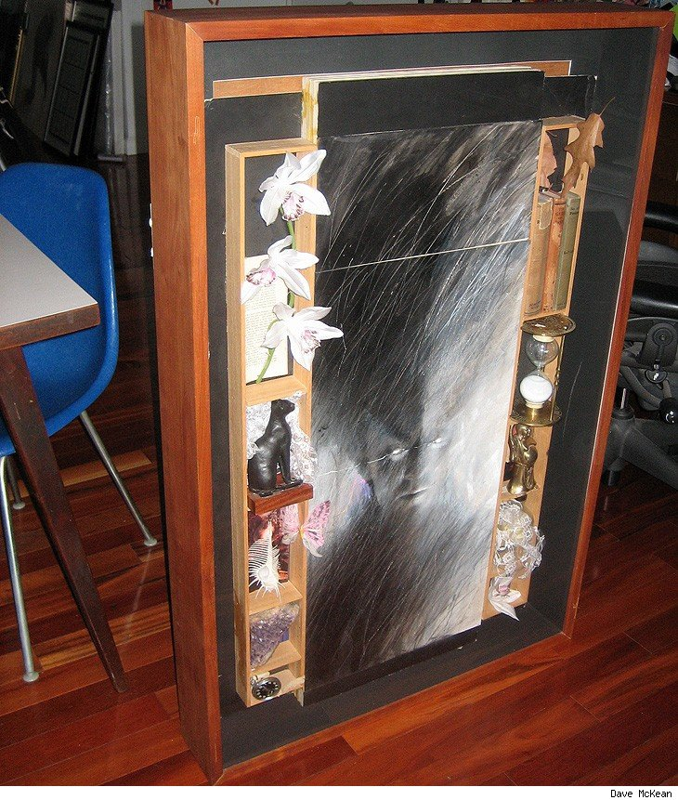
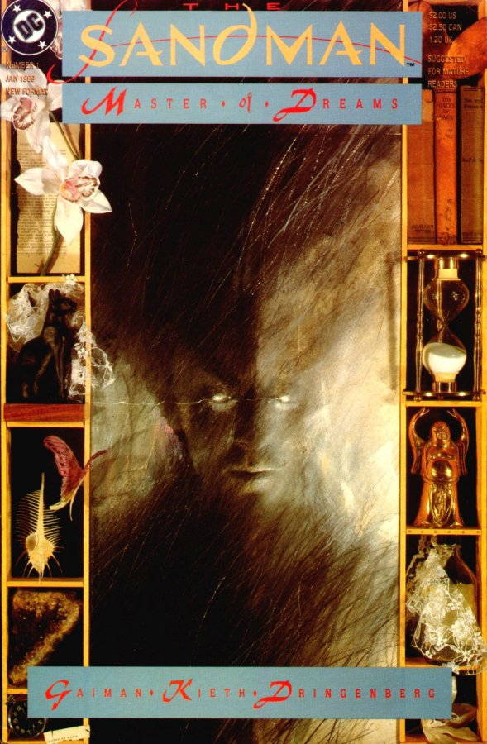
Sandman Cover
Dave McKean
Mixed Media
McKean’s work on the covers for Neil Gaiman’s Sandman comic books employ a collage aesthetic. Though the final image looks like it was likely made in a traditional, two dimensional way, they were, in the beginning, made as low relief sculptural dioramas and then photographed for the final piece.

Slide 15
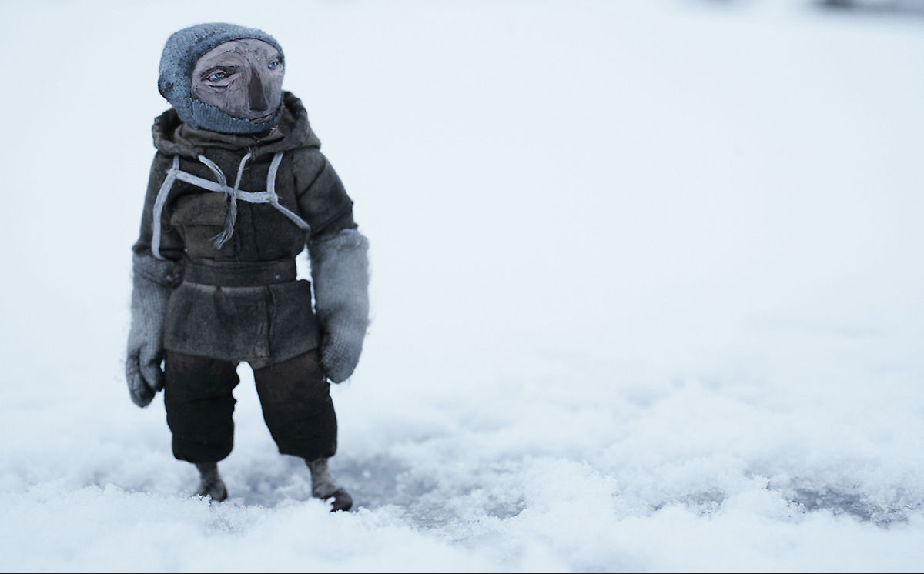
Waiting for Shakleton
Red Nose Studio
Mixed Media
This personal piece from Red Nose Studios is based on the harrowing experience of a failed expedition in the early 1900s by Ernest Shackleton in which his ship and crew became stuck in arctic sea ice and were stranded for over a year. In this time, the only loss of life was the dogs from their dog sled team.

Slide 16
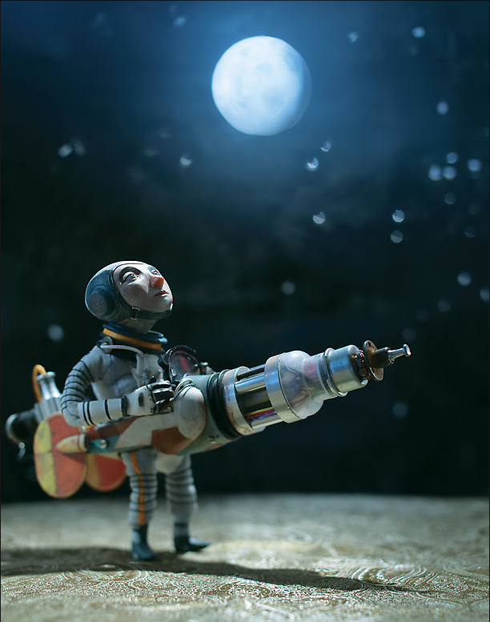
Having Goals
Red Nose Studios
Mixed Media
This image, which was created to accompany an article in Plansponsor magazine, shows a would-be astronaut longingly staring up at the moon, which is likely his ideal destination, while wearing a rocket apparatus that will probably not get him there, but there is determination on his face. This whimsical humor is typical in the work of Red Nose Studios.

Slide 17
GALLERY ART
The distinction between the fine and commercial arts has been a point of heated contention between many people for a long, long time. Illustration’s place in the world of visual culture is thus shifted up and down through hierarchy of visual importance wildly depending on who you talk to and what you read. It is then, with sculptural illustration, that the line between the two can be made so blurry that perhaps it is no longer a valuable question to ask and images and objects can then be weighed based on their individual merits and against a smaller group of individual images and objects rather than lumping those things in with the entire history of created art.

Slide 18
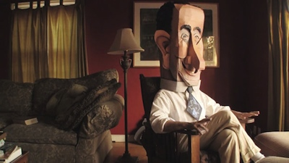
LBJ Mask
Wayne White
Mixed Media
Wayne White is a renaissance man, drifting seamlessly through the worlds of sculpture, painting, illustration, puppetry, and various other mediums. This large, cardboard caricature mask of the ex-president LBJ is featured in the documentary about White’s work “Beauty is Embarrassing”.

Slide 19
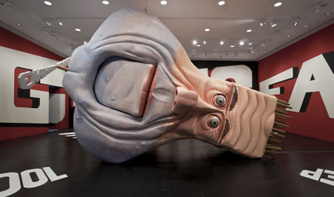
Big Lectric Fan to Keep Me
Cool While I Sleep
Wayne White
Mixed Media
Humor and caricature plays a large part in White’s work, and is something that sets him apart from many artists that display their work primarily in a gallery setting. This room sized sculpture of the country singer George Jones’ head contains eyes that spin in their sockets, a mouth that opens and closes, a giant word fan protruding from its neck. The title is from a song by George Jones.

Slide 20
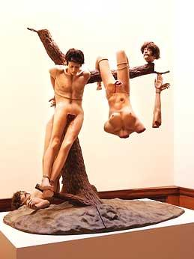
Disasters of War
Jake and Dinos Chapmon
Mixed Media
Various Sizes
Are sculptural recreations of illustrations still illustrations? These sculptures by the Chapman Brothers and three dimensional representations of the Disasters of War drawings and etchings by the artist Francisco De Goya, which were a scathing social commentary on the place of war in a civilized society.

Slide 21
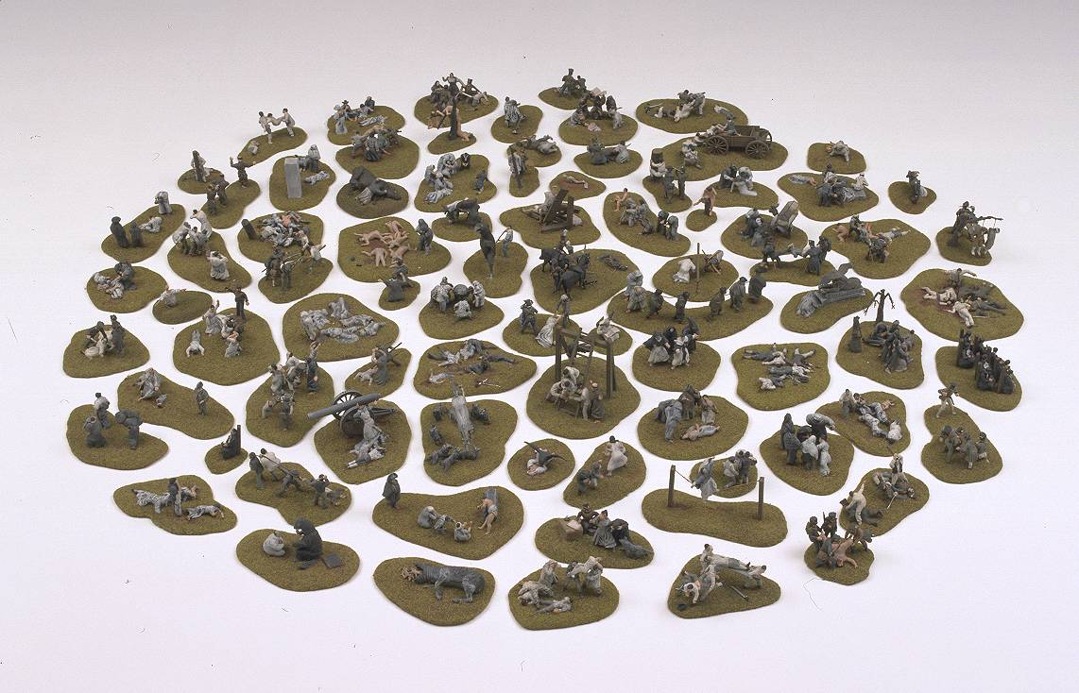

Slide 22
